Slide 1
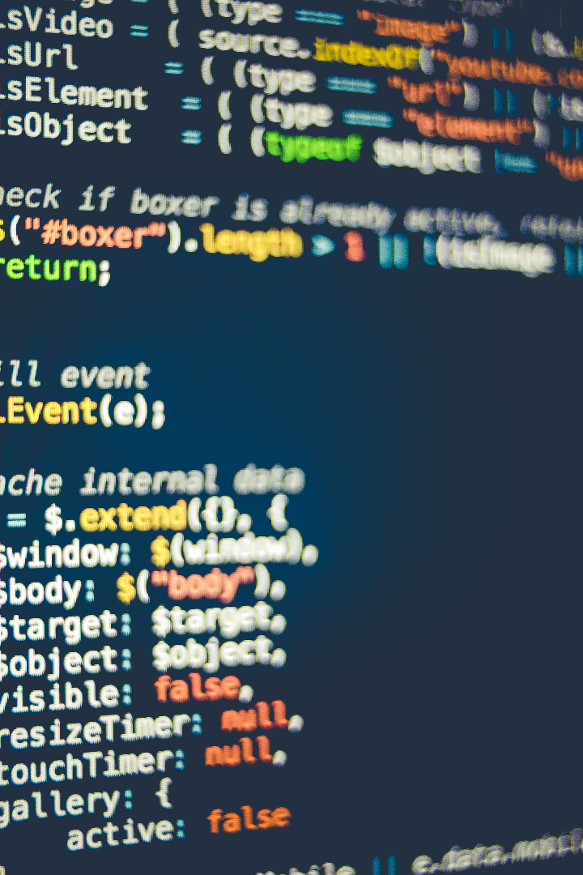
Indentations in C Language
In this presentation, we will explore the importance of proper indentation in C programming and examine common indentation styles used. Let's dive in!

Slide 2
Why Indentation Matters
1
Readability 📖
2
Error Detection 🔍
3
Collaboration 🤝
Indentation enhances code readability, making it easier to understand and maintain.
Proper indentation helps identify missing or mismatched brackets, improving code accuracy.
Consistent indentation allows teams to collaborate seamlessly by following a uniform style.

Slide 3
Syntax Rules for Indentation
Brace Placement
Consistent Spacing
Curly braces should be placed at the same level of indentation as the surrounding code.
Use either spaces or tabs to maintain consistent spacing for indentation.
Aligning Statements
Comments
Align statements within a block to improve readability and organization.
Place comments in line with the code they refer to, maintaining the same level of indentation.

Slide 4

Common Indentation Styles
1
Allman Style
Each opening brace is placed on a new line, indented at the same level as the preceding code.
2
K&R Style
Opening brace is placed on the same line as the preceding code, indented at the same level.
3
GNU Style
Opening brace is placed on the same line as the preceding code, indented with an additional level.

Slide 5

The Benefits of Proper Indentation
1
Efficiency ⌛️
2
Understanding 🤔
Readable code is easier to debug and maintain, saving time and effort in the long run.
Indents help programmers grasp the code logic and understand complex structures.
3
Consistency ✅
Consistent indentation creates a cohesive codebase, improving collaboration and scalability.

Slide 6
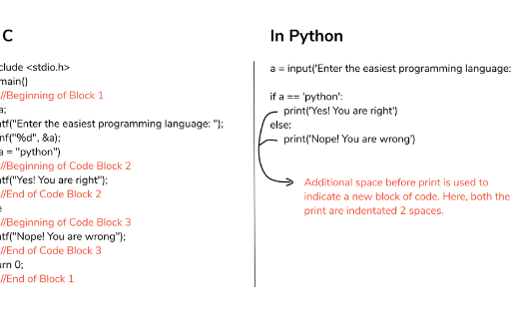
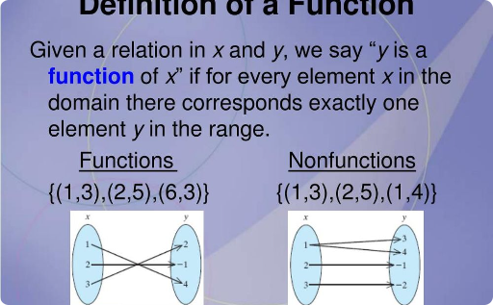
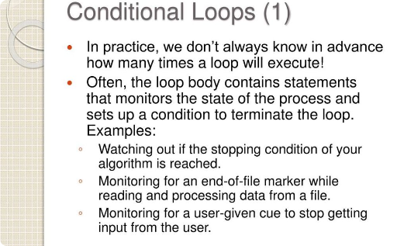
Properly Indented C Code Examples
Structures
Functions
Loops & Conditionals
Properly indented code for defining and using structures in C programming.
Clear indentation for function definitions and function calls in C code.
Readable indentation for loops and conditional statements, improving code flow.

Slide 7
Conclusion
Clean Code
Proper indentation improves code clarity and maintainability. Enhance your C programming skills with consistent and readable code!

